Slide 1
Support Vector Machine meets Software Defined Networking in IDS domain
Luca Boero, Mario Marchese, and Sandro Zappatore
Department of Electrical, Electronic and Telecommunications Engineering, and Naval Architecture (DITEN), University of Genoa, Italy
Published in: 2017 29th International Teletraffic Congress (ITC 29)

Slide 2
Introduction
Malware
Software specifically designed to insert itself in a computer system without the approval of the owner using techniques such as trojans, backdoors, keylogger, and worms

Slide 3
Introduction
Malware
Software specifically designed to insert itself in a computer system without the approval of the owner using techniques such as trojans, backdoors, keylogger, and worms
Intrusion Detection System (IDS)
A piece of hardware/software designed to alert when someone or something is trying or has tried to compromise systems.

Slide 4
Introduction
Misuse Detection
Fix a specific abnormal behavior and considers the rest as normal
Consists of signature based, rule based, state transition algorithms, and data mining

Slide 5
Introduction
Misuse Detection
Fix a specific abnormal behavior and considers the rest as normal
Consists of signature based, rule based, state transition algorithms, and data mining
Anomaly Detection
Describes the normal behavior and marks as abnormal what is not considered normal
Consists of statistical, distance, profile, and model-based schemes

Slide 6
Introduction
Intrusion detection methods collect signature and information of the flow under analysis
Need to open each packet of the flow up to application layer
Usually results in good performance
High complexity of time and resources

Slide 7
Introduction
Intrusion detection methods collect signature and information of the flow under analysis
Need to open each packet of the flow up to application layer
Usually results in good performance
High complexity of time and resources
Statistical-based anomaly detection methods
In order to reduce the costs, measures only the temporal statistics to detect anomalies

Slide 8
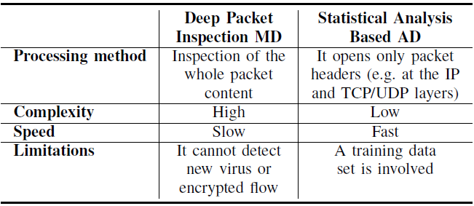
Introduction

Slide 9
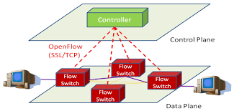
Introduction
Software Defined Network (SDN)
Separates data and control actions operated by networking devices such as switches and routers
Data functions are located within devices, while control functions are concentrated in SDN controllers

Slide 10
Introduction
Software Defined Network (SDN)
Separates data and control actions operated by networking devices such as switches and routers
Data functions are located within devices, while control functions are concentrated in SDN controllers
Easy to embed IDS model into centralized controller as one of services
Feature extraction is limited, since only the first packet of the flow is received by controller

Slide 11
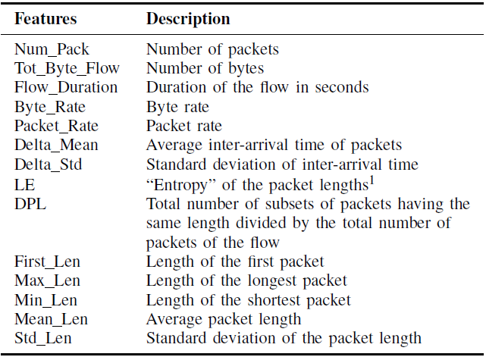
Introduction

Slide 12
Introduction
Used for SDN

Slide 13
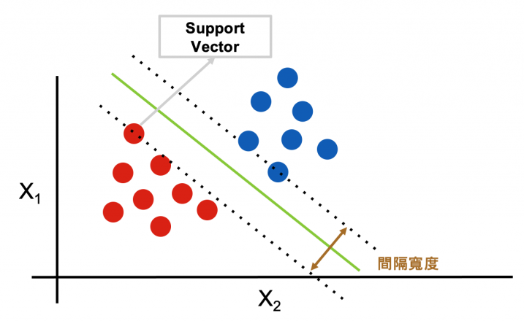
Introduction
Support Vector Machine (SVM)
Find a hyperplane to classify data by mapping features to higher dimension

Slide 14
Introduction
Support Vector Machine (SVM)
Use kernel function to represent the scalar product of some feature mapping space, which reduce a lot of computation complexity
Popular kernel functions include linear, polynomial, RBF and sigmoid kernels

Slide 15
Introduction
Support Vector Machine (SVM)
Linear kernel is mostly preferred for text-classification problems

Slide 16
Introduction
Support Vector Machine (SVM)
Linear kernel is mostly preferred for text-classification problems
Polynomial kernel gives good results with normalized data

Slide 17
Introduction
Support Vector Machine (SVM)
Linear kernel is mostly preferred for text-classification problems
Polynomial kernel is a generalized representation of linear kernel
Radial Basis Function (RBF) kernel helps when no prior assumptions

Slide 18
Introduction
Support Vector Machine (SVM)
Linear kernel is mostly preferred for text-classification problems
Polynomial kernel is a generalized representation of linear kernel
Radial Basis Function (RBF) kernel helps when no prior assumptions
Sigmoid kernel usually used for neural networks, since it’s similar to a two-layer perceptron

Slide 19
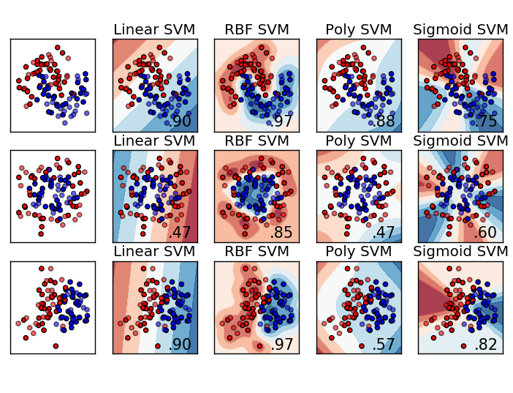
Introduction
Support Vector Machine (SVM)

Slide 20
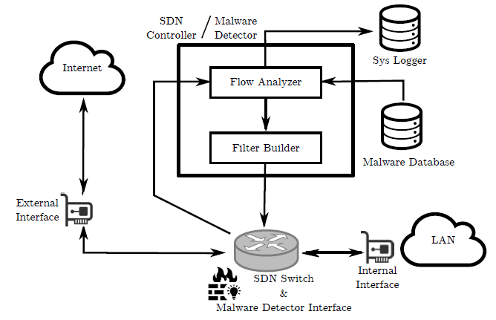
Architecture of Proposed Solution

Slide 21
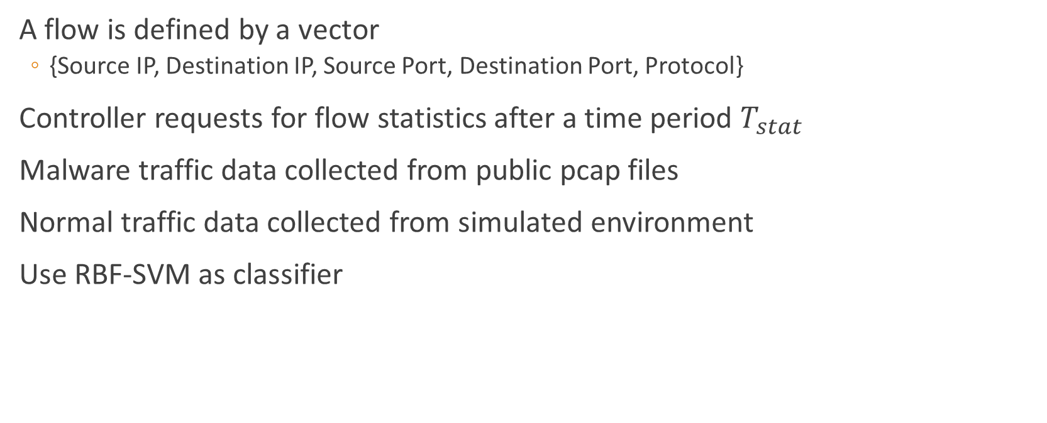
Experiment
A flow is defined by a vector
{Source IP, Destination IP, Source Port, Destination Port, Protocol}
Controller requests for flow statistics after a time period $T_{stat}$
Malware traffic data collected from public pcap files
Normal traffic data collected from simulated environment
Use RBF-SVM as classifier

Slide 22
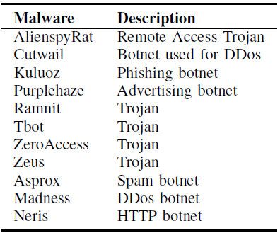
Experiment

Slide 23

Experiment
Evaluation Metrics
True positive rate
$\frac{TP}{TP+FN}$
False positive rate
$\frac{FP}{FP+TN}$

Slide 24
Experiment
Used for Training and Testing

Slide 25
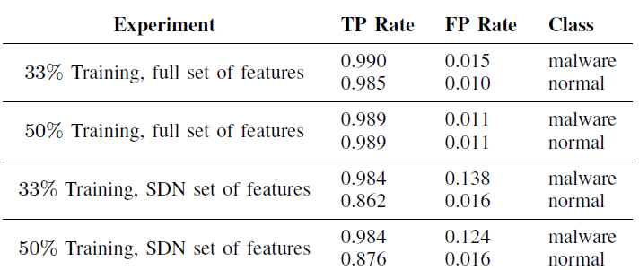
Experiment

Slide 26
Experiment Settings
Training set
Testing set

Slide 27
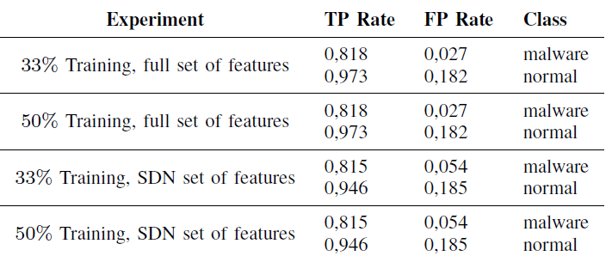
Experiment

Slide 28
Conclusion
Proposes a Statistical Analysis SDN-based IDS
Easy to implement, apply in real world
Performance using limited set of features is still satisfying

